Slide 1
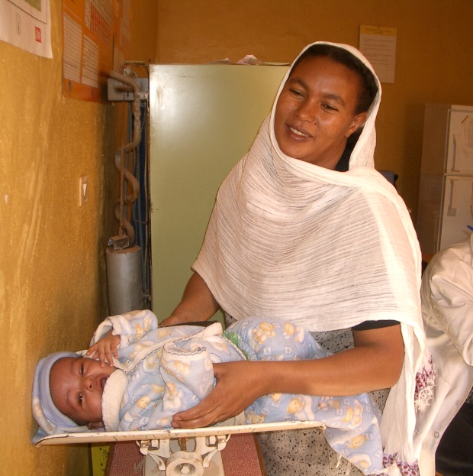

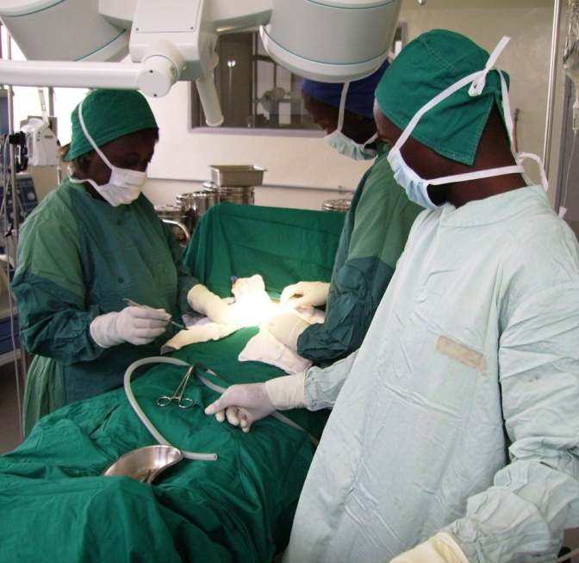
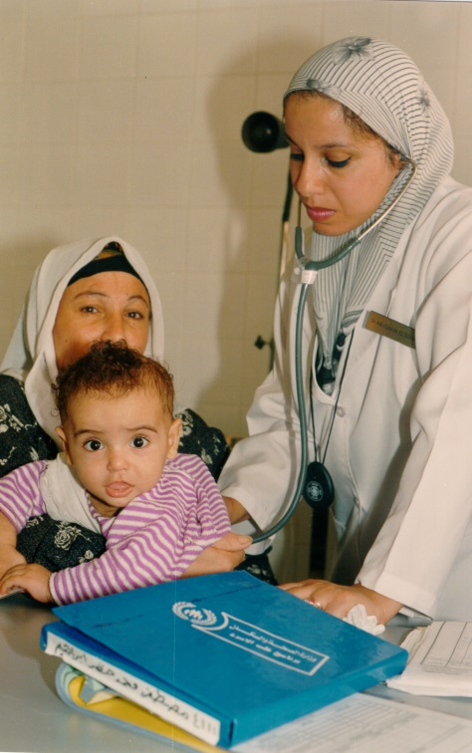
IHD Service Delivery and Quality Assurance
Technical Working Group

Slide 2
What is service delivery?
The organization and management of inputs and services to those who need them, when and where they are needed (WHO 2001c).
An immediate output of the inputs into the health system, such as the health workforce, procurement and supplies, and financing. Increased inputs should lead to improved service delivery and enhanced access to services.
Notes:
WHO:
Service provision or delivery is an immediate output of the inputs into the health system, such as the health workforce, procurement and supplies, and financing. Increased
inputs should lead to improved service delivery and enhanced access to services.
HS 20/20 HSA How-to Manual:
WHO defines service delivery as the way inputs are combined to allow the delivery of a series of interventions or health actions (WHO 2001c) through multiple actors in the public and private sectors. As noted in WHO’s Systems Thinking for Health Systems Strengthening (De Savigny and Adam 2009), service delivery includes “effective, safe and quality personal and non-personal health interventions that are provided to those in need, when and where needed (including infrastructure), with a minimal waste of resources.” The report Everybody’s Business: Strengthening health systems to improve health outcomes, WHO’s framework for action (WHO 2007) states that “the service delivery building block is concerned with how inputs and services [in both public and private sector] are organized and managed, to ensure access, quality, safety and continuity of care across health conditions, across different locations and over time.”
PEPFAR:
Service Delivery means quality, efficiency, equity, accessibility, patient-centeredness, and safety
Good health services are those which deliver effective, equitable, safe, high quality personal and non-personal health interventions to those who need them, when and where they are needed, with efficient use of resources.
HSS is spending that strengthens systems that support service delivery
Some concepts that have frequently been used to measure health services remain extremely relevant and are part of the key characteristics. For example, terms such as access, availability, utilization and coverage have often been used interchangeably to reveal whether people are receiving the services they need (2, 3). Access is a broad term with varied dimensions: the comprehensive measurement of access requires a systematic assessment of the physical, economic, and socio-psychological aspects of people’s ability to make use of health services. Availability is an aspect of comprehensiveness and refers to the physical presence or delivery of services that meet a minimum standard. Utilization is often defined as the quantity of health care services used. Coverage of interventions is defined as the proportion of people who receive a specific intervention or service among those who need it.

Slide 3
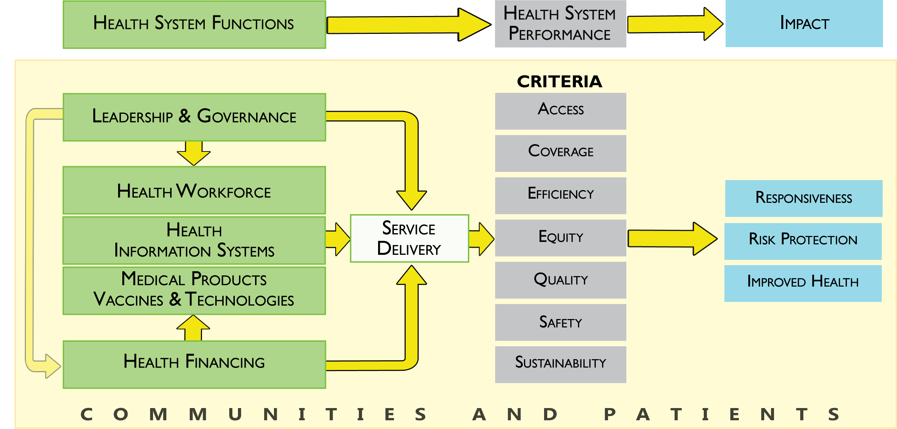
Health System Building Block Interactions
Notes:
From HSA How-to manual
Health service delivery can be represented from the systems perspective, with inputs, processes, outputs, and impacts. Among the core inputs and processes that are necessary for health care delivery, regardless of the sector, are financial resources, competent health care staff, adequate physical facilities and equipment, essential medicines and supplies, up-to-date clinical guidelines, operational policies, and record keeping.
These allow the health provider or health facility to effectively and efficiently provide services to the patient.
Leadership and Governance: Deals with the key policy barriers to enhance quality, Access, Efficiency (i.e. Policy to allow midwives to perform active management of the third stage of labor (AMTSL))
Health Workforce: Ensures there are sufficient health personnel by cadre and by region, deployment to underserved areas, training curricula guidelines, certification
Health Information Systems: Provides information and data on allocation of HRH, HRH health personnel numbers, disease surveillance- when there are outbreaks of significantly high child mortality in one region so that the HS actions can response appropriately, whether there are adequate supplies of essential medicines in one.
Medical Products and vaccines and technologies: Allows the provider to diagnose and deliver the appropriate preventions interventions and treatment whether it be x-ray equipment to diagnose pneumonia, bednets to prevent malaria, antibiotics to treat bacterial infections
Health Financing: Deals with financing he mobilization, accumulation and allocation of funds to cover the cost of training and compensating health workers, procuring medicines and equipment and infrastructure

Slide 4
Key components of Service Delivery
Standards and guidelines
Pre-service and in-service training
Task-shifting
Referral systems
Quality improvement systems and supportive supervision

Slide 5
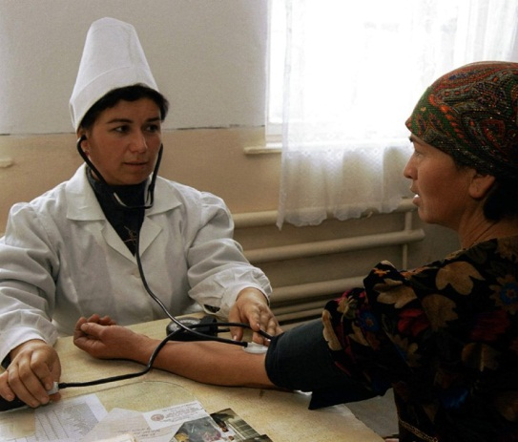
Standards and Guidelines
These provide guidance to providers on how to improve quality health services according to national protocols and international recommendations
Requires buy-in and consensus among all stakeholders
Project example: Azerbaijan: establishment of national clinical practice guidelines
Notes:
Standards and Guidelines: Standards and guidelines are the cornerstone of most health care improvement approaches, including accreditation of health facilities, external quality evaluation, continuous quality improvement, and performance improvement. Standards and guidelines provide guidance to providers on how to improve quality health services according to national protocols and international recommendations. They also can improve equity of service delivery, as they help to increase access to the underserved to receive quality services that effectively improve their health status irrespective of their gender and affordability to pay.
Challenges/Issues: Developing and updating national standards and guidelines requires buy-in and consensus among all stakeholders in order to be implemented effectively and efficiently. Service delivery guidelines should be evidence-based and tailored to the local context, guide the resource allocation process, ensure capacity building and supervision of health care providers, and measure the client satisfaction including output indicators. Rolling out new or revised standards and guidelines to providers at the facility level in a timely manner requires diligent planning and adequate financial resources to reach all providers and all facilities.
Example: In Azerbaijan Abt introduce supported the establishment of a national evidence-based medicine center at the MOH and equipped the Center’s staff with the skills and structure necessary to lead the process of clinical practice guidelines (CPG) development. With Abt support, the MOH developed 72 CPGs covering priority health issues, both with and without technical assistance from the project.

Slide 6
QI Systems and Supportive Supervision
Using routine health and program data to improve service systems and processes that meet client and program needs.
Must be aligned and integrated with broad health systems and infrastructure improvement interventions.
Project examples:
Dominican Republic: Centers of Excellence to improve quality of services
Ethiopia and Nigeria: use of mobile devices to improve supportive supervision
Nigeria GxAlert: New technology for rapid diagnosis and dissemination of TB test results
Notes:
Quality improvement Systems and Supportive Supervision: Quality improvement (QI) is an approach to improvement of service systems and processes through the routine use of health and program data to meet client and program needs. QI is a formal approach to the analysis of performance and systematic efforts to improve it. QI involves both prospective and retrospective reviews. It is aimed at improvement -- measuring where you are, and figuring out ways to make things better. QI activities are intended to identify gaps in the system. It focuses on all levels of the system, including how services are organized, leadership, monitoring systems, adequate infrastructure, human resources, medical and material supplies, and laboratory facilities both in the public and private sector facilities. Abt uses a team-based problem solving approach that focuses on the needs of the client, that is data driven and provides leadership support to improve the overall system. There are other approaches to improve quality of care such as collaboratives, standards-based management and recognition, and performance improvement.
Supportive supervision is a component of QI system. Supportive supervision is a process whereby supervisors carry out visits to health centers to monitor health workers’ on the job performance. During the visits the supervisor and health workers work together to identify and address weaknesses on the spot, thus preventing poor practices from becoming routine. A key principle of supportive supervision is working with health staff to establish goals, monitor performance, identify and correct problems, and proactively improve the quality of care. Supervisory visits are also an important component and opportunity to recognize good practices and help health care workers to maintain a high-level of performance and help to optimize the allocation of resources. Supportive supervision promotes quality at all levels of the health system by strengthening relationships and promoting teamwork and improves two-way communication. Supportive supervision system can be a challenge to implement in rural areas where health facilities are far, infrastructure is poor, and roads are impassable.
Challenge/Issues: Quality improvement and supportive supervision systems must be aligned and integrated with broad health systems and infrastructure improvement interventions to be effective.
Example:
Dominican Republic. The Maternal & Child Centers of Excellence in the Dominican Republic uses a "diagonal approach" which combines health systems strengthening interventions with maternal and child health services quality improvements. The project developed 10 hospitals as Centers of Excellence to create a cohort of "positive deviants" that will share best practices and lessons learned with other hospitals across the country. Keys to improve service performance include: Proper selection and preparation of management teams to alter their default future and shift to a declaration of a new future; Use of the Common Assessment Framework tool for Quality Management; Development of an strategic thinking that contributes to expand a powerful sense of alignment to their goals; Strengthening of the Hospital Administration Councils to foster community oversight and accountability; Emergency Obstetric and Neonatal Care training to improve evidence-based knowledge and clinical competencies in providers; Development of Customer Service Offices to improve the capacity to provide better health care and service to users; Biosafety and Infection prevention to improve knowledge and skills to manage and control risks for patients, providers and the environment; and Development and implementation of an executive information system to increase awareness and data-based decision making.
Under the Health Systems 20/20 Project Abt introduced the use of mobile devices to improve supportive supervision of health workers in Ethiopia and Nigeria. TB and HIV/AIDS clinic supervisors used PDAs to facilitate monitoring and priority setting. Moving from a paper-based supportive supervision checklist to PDAs enables immediate analysis on site for action planning, and facilitates comparisons and resource allocation across the system.
Ethiopia. Under the Private Health Sector Project (PHSP), a global health project that worked to strengthen health systems in developing countries, Abt introduced the use of mobile devices to improve supportive supervision of health workers in Ethiopia. Health workforce shortages and other challenges weaken health systems. Through the introduction of data-driven quality assessment tools, Abt demonstrated how technology can improve service provision. PHSP supported TB and HIV/AIDS clinic supervisors to move from using a paper-based supportive supervision checklist to using PDAs to collect data during supportive supervision visits. This allowed the data to be immediately uploaded to a database and also immediate analysis on site during supportive supervision visits, enhanced the ability of health facilities to do action planning to correct deficiencies identified during supportive supervision visits, and facilitated comparisons in quality of services and resource allocation across the health systems. Furthermore, use of mobile phones for supportive supervision improved quality of services. For example, the HIV testing rate among TB patients dramatically increased from below 50% in 2008 to above 80% in 2013.
Nigeria. Using Smartphones in Nigeria to collect TB data has eliminated the need for printed forms, minimized human error in data entry, reduced the lag time of availability of data for policymakers and managers, and helped pinpoint ways to improve delivery of care. Health Systems 20/20, in collaboration with the National TB and Leprosy Training Centre in Zaria and the Boston-based firm Avid Database Solutions, piloted the use of personal digital assistants (PDAs) in 16 facilities in eight local governments in four states to strengthen supportive supervision (SS) of TB treatment, diagnosis, operational procedures, and data reporting at the facility and local-government level. During scale-up, the project migrated from PDAs to Smartphones to enable enhanced data sharing capabilities and easier analysis on the phone itself so that quality improvement (QI) plans could be made on the spot during a supervision visit; the project scaled up to over 200 facilities in 2011-2012
The QI plans highlight the most pressing areas for improvement and identify and prioritize interventions. In many cases on-the-spot corrections are made and in other cases, systemic problems are fixed. As a result, drug stock-outs have decreased and long-term initiatives to reduce defaulter rates have been introduced.
SS visits are done either monthly or quarterly at the facilities to provide comprehensive monitoring of all clinical, commodity, and laboratory functions that support TB care. The use of a checklist on the Smartphone allows for immediate data analysis and creation of data-driven QI plans. Checklists including information on labs and drug supply are programed and loaded onto Smartphones. Use of the PDAs/Smartphones succeeded in replacing an existing paper-based system for collecting facility-level TB data.
Preliminary results show:
Abia State:
66% increase of TB-HIV patients on CPT
33% decrease in TB treatment defaulter rate
64% increase of TB-HIV patients on ARV
Lagos State:
42% increase of TB-HIV patients on CPT
71% decrease of TB treatment defaulter rate
26% increase of TB-HIV patients on ARV
Further analysis over the next six months is expected to validate these findings and show additional impact. Smartphones were seen as a catalyst to the widespread adoption of this new system. Positive initial results led the NTBLCP to endorse scale up of the smartphone based activity with Abt’s support to over 600 facilities across 7 states by October 2013.
GX Alert: In many countries, a sputum sample is collected at remote clinical sites and sent to a central lab for testing. Test results are then reported back to the clinical site where they are manually transcribed into lab registers. Those registers are keyed into an existing central monitoring and evaluation (M&E) system for analysis often weeks or months later, leading to potentially harmful delays in treatment and program monitoring. The GeneXpert™ is a self-contained diagnostic tool used for rapid tuberculosis (TB) testing at remote clinical sites; Nigeria’s Federal Ministry of Health (FMOH) has rolled GeneXpert™ systems out to 40 sites across the country.
Abt is supporting the FMOH to further leverage the rapid results from the GeneXpert™ by incorporating a 3G USB modem to automatically send the results to GxAlert, a web-based database designed by Abt that aggregates Multi-Drug Resistant (MDR)-TB test results, sends the information in real-time directly into FMOH’s national TB M&E system (eTB Manager) and automatically sends notifications to State TB Control Officers and Lab Managers. The GxAlert system enables the FMOH to begin MDR treatments for patients faster and, based on test result patterns, move second line TB treatment drugs to remote facilities where they are needed the most.

Slide 7
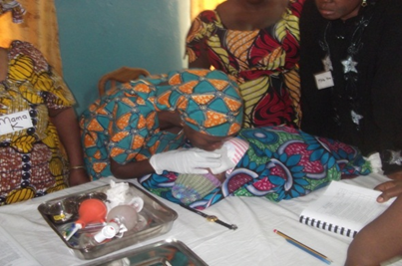
Pre-Service and In-Service Training
Education to develop knowledge and skills before a health care professional enters health service practice and continued intermittently to improve the level of the health professional’s competence and strengthen the provider’s knowledge, skills, and attitudes
Project example:
Central Asia Central Asia Quality Health Care Project/ ZdravPlus
Mali Assistance Technique Nationale Plus: Training of auxiliary midwives in AMTSL
Notes:
Pre-service and In-service Training: Pre-service training refers to education to develop knowledge and skills before a health care professional enters public health service or private practice, such as medical school, nursing school, and midwifery school. In-service training refers to training of health care professionals already employed (e.g. health providers working in the public or private sector) to improve the level of the health professional’s competence and strengthen the provider’s knowledge, skills, and attitudes.
PATHS II in Nigeria delivers high-quality trainings on the active management of third stage of labor (AMTSL) to frontline health workers in rural areas. PATHS 2 also provides health workers with life-saving standard operating protocols and job aids.
In collaboration with other USAID implementing partners Mali, the Assistance Technique Nationale (ATN) Plus carried out a pilot to train auxiliary midwives to delivery AMTSL. Pilot results demonstrated that midwives were capable of delivering AMTSL (post pilot training showed results that auxiliary midwives’ skill level matched that of a skilled birth attendant in regarded to AMTSL). Post pilot ATN trained one midwife per health center for the districts where we worked while other implementing USAID partners trained the midwives in other health centers.
Central Asia:
Zdrav:
preparing family medicine providers within medical schools
Training Laboratory workers
supporting development and implementation of evidence-based clinical guidelines
training health care providers on family planning, safe motherhood, child health, infectious disease, and hypertension

Slide 8
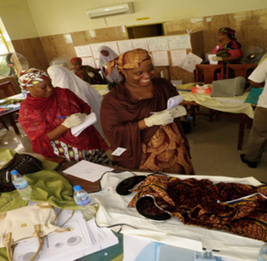
Task-Shifting
WHO describes task shifting as “the rational redistribution of tasks among health workforce teams”
Encompasses efforts at both upstream (policies) and Implementation (hands-on task demonstrations etc.)
From highly qualified to shorter trained and fewer qualifications to make more efficient use of the scarce HRH available
Should include continuous monitoring and quality assurance mechanisms
Project example:
Mali Assistance Technique Nationale Plus: Task shifting of AMTSL to auxiliary midwives
Nigeria PATHS2: Competency based trainings for CHEWs on Emergency Obstetric (EmOC) service provision (AMSTL, infection prevention, LSS and ENC) in PHCs
Notes:
Task-shifting: In most low-income countries, human resource shortages are the most significant barrier to delivery of quality health services. Task shifting is a strategy to address the human resource challenge by getting the right workers with the right skills in the right places doing the right things. The World Health Organization describes task shifting as “the rational redistribution of tasks among health workforce teams. Specific tasks are moved, where appropriate, from highly qualified health workers to health workers with shorter training and fewer qualifications in order to make more efficient use of the available human resources for health .
Challenges/Issues: Challenges with task shifting include hesitancy from traditional cadres of workers to turn over their roles to less highly trained workers. There are concerns that focusing on task shifting as the solution can overshadow persistent challenges with training and retraining high-quality health care providers. Task shifting must be combined with broader health systems strengthening. Task shifting should include continuous monitoring and quality assurance mechanisms including motivation, retention and performance monitoring of workers.
Example: In collaboration with other USAID implementing partners Mali, the Assistance Technique Nationale (ATN) Plus carried out a pilot to train auxiliary midwives to delivery AMTSL. Pilot results demonstrated that midwives were capable of delivering AMTSL (post pilot training showed results that auxiliary midwives’ skill level matched that of a skilled birth attendant in regarded to AMTSL). ATN provided TA to the MOH to disseminate pilot results and advocate for policy reform. ATN provided TA to the MOH to reform the policy to allow midwives to delivery oxytocin, which is critical to AMTSL. ATN then trained supervisors (nurses, physicians, midwife from the district level hospital) to supervise and provide oversight to the auxiliary midwives in the provision of AMSTL. ATN trained one midwife per health center for the districts where we worked while other implementing USAID partners trained the midwives in other health centers.
Task-shifting: Ethiopia is currently undergoing a large scale-up initiative to increase access to care throughout the country. The cost of training new healthcare providers is significant, and Ethiopia has turned to task-shifting as a promising method for rapid scale-up. Abt worked with the Ministry to determine the economic impact of task-shifting ART services. The cost-effectiveness analysis looked at the changes in costs associated with starting and sustaining task-shifting, along with the associated costs in observed changes to health outcomes to help the Ministry determine how cost effective wide scale-up of the model would be.

Slide 9

Referral Systems
A process in which a health worker at a one level of the health system, seeks the assistance of a better or differently resourced facility at the same or higher level to assist in, or take over the management of a client’s case
Must have continuous monitoring and supportive supervision mechanisms established
Project examples:
Jordan/SHOPS: Using home visits and vouchers for family planning
Nigeria PATHS2: Two-way referral systems for EmOC
Notes:
Establishing referrals: A referral can be defined as a process in which a health worker at a one level of the health system, having insufficient resources (drugs, equipment, skills) to manage a clinical condition, seeks the assistance of a better or differently resourced facility at the same or higher level to assist in, or take over the management of the client’s case. The facility that accepts the referred case is called the receiving facility and at the end of their involvement, they prepare a counter referral on the lower part of the forms to let the initiating facility know what has been done. This completes the referral loop between the two facilities.
A good referral system can help to ensure:
Clients receive optimal care at the appropriate level that are not unnecessarily costly;
Hospital facilities are used optimally and cost-effectively;
Clients who most need specialist services can access them in a timely way; and
Primary health services are well utilized and their reputation is enhanced.
Challenge: Health provider compliance with referral guidelines and client follow- up are often challenging in low resource settings and particularly in rural areas. Services offered at referred facilities may be perceived as inadequate quality or culturally inappropriate by clients or the transport is either not available or costly. In order to have a referral system that is working effectively, there needs to be continuous monitoring and supportive supervision mechanisms established.
Example: In Jordan, Abt recruited and trained community health workers to provide health communications messages, and provided referrals and vouchers for family planning care services to private clinics through home visits.
37,752 referrals distributed, 28,184 (75%) redeemed for family planning services. Referrals include free, discounted and normal referrals.
16,572 free vouchers distributed, 8,668 (52%) redeemed for family planning services
Jordan-153,023 women received FP counseling through outreach

Slide 10
Select Abt Projects with Service Delivery/Quality Assurance
Nigeria Partnership for Transformation of Health Systems
Nigeria/SHOPS
Zambia Integrated Systems Strengthening Program
Zambia Scaling up Family Planning
Mali Assistance Technique Nationale Plus
Ethiopia Private Health Sector Program
Central Asia Quality Health Care Project
Dominican Republic Maternal & Child Centers of Excellence Project
Peru MCC
Health Systems Project Senegal
Bangladesh/SHOPS
Jordan Health Systems Strengthening II
Jordan/SHOPS Ta’ziz
Azerbaijan Strengthening Health Systems Through Integrated Programs Armenia- Health System Strengthening in Armenia
Pakistan Technical Assistance for Capacity Building in Midwifery, Information and Logistics
India/SHOPS
India Market Based Partnerships for Health
India Integrated Family Health Initiative
Health Systems Project Indonesia
Clinical HIV/AIDS Services Strengthening Project in Sofala, Manica, and Tete Mozambique

Slide 11
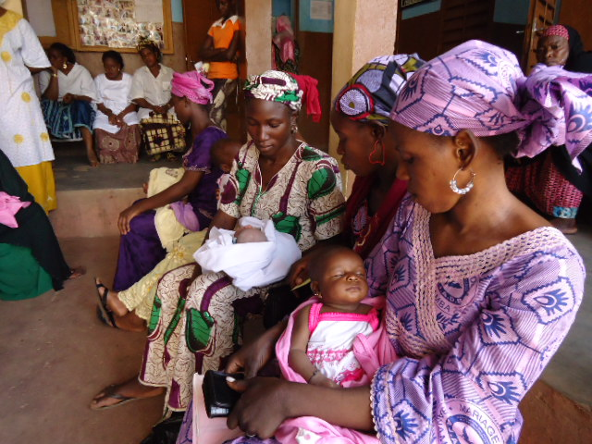
Thank you !
The Service Delivery/Quality Assurance TWG Core Team
TL: Kuhu Maitra
TC: Kenya Datari
TWG members:
Melinda Ojermark
Leah Ekbladh
Lara Hensley
Lisa Nichols
Margarita Fernandez
Carlos Cuellar
Maha Al-Saheb
Ekpenyong Ekanem
Sabry Hamza
Amina Aminu
Ayman Mohsen
Mali ATN Plus

